Slide 1
AAP Bright Futures National Center
Bright Futures: Guidelines for Health Supervision of Infants, Children, and Adolescents, 4th Edition
Promoting Food Security
Authors: Austin Han, MD and Robert C. Lee, DO, MS, FAAP
Notes:
Facilitator Guide:
Welcome to this Bright Futures mini training learning activity on Promoting Food Security.

Slide 2
Author & Disclosure Information
Austin Han, MD
PGY-1
NYU Long Island School of Medicine
Robert C. Lee, DO, MS, FAAP
Assistant Professor of Pediatrics
Associate Residency Program Director
NYU Long Island School of Medicine
Note: The recommendations in this presentation/training do not indicate an exclusive course of treatment or serve as a standard of care. Variations, taking into account individual circumstances, may be appropriate.
Citation: If you plan to use this resource, please cite or credit as: Han A, Lee RC (2022) Bright Futures: Promoting Food Security PowerPoint Slides]. 2023. Accessed <date>. https://www.aap.org/en/practice-management/bright-futures/bright-futures-in-clinical-practice/bright-futures-educational-resources/
This program is supported by the Health Resources and Services Administration (HRSA) of the US Department of Health and Human Services (HHS) as part of an award totaling $5,000,000 with 10 percent financed with non-governmental sources. The contents are those of the author(s) and do not necessarily represent the official views of, nor an endorsement, by HRSA, HHS, or the US Government. For more information, please visit HRSA.gov.
Notes:
Facilitator Guide:
The authors have no disclosures.

Slide 3
Pre-test
Evaluate your knowledge about the topic before the mini training. Please click on the pre-test link below.
Please click on link to be routed to the pre-test
NOTE: This is for learning purposes only and is NOT approved for CME.
Notes:
Facilitator Guide:
Please complete the pretest prior to reviewing the presentation

Slide 4
Main Objectives
Describe the role of pediatric health care professionals in screening and identifying children at risk for food insecurity and in connecting families to needed community resources
Recognize the negative impacts on health, development, and well being of children who are experiencing food insecurity
Describe the use of Hunger Vital SignTM to screen for food insecurity¹
Develop a comfort level in speaking with families on this topic without creating stigma and providing positive presentation of programs and resources
Notes:
Facilitator Guide:
Food insecurity is a critical child health issue that impacts millions of infants, children, youth, and families in all communities across the U.S. Children of all ages who live in household with food insecurity are likely to be sick more often, recover from illness more slowly, and be hospitalized more frequently.
The main objectives of this module are:
Describe the role of pediatric health care professionals in screening and identifying children at risk for food insecurity and in connecting families to needed community resources
Recognize the negative impacts on health, development, and well being of children who are experiencing food insecurity
Describe the use of Hunger Vital Sign to screen for food insecurity
Develop a comfort level in speaking with families on this topic without creating stigma and providing positive presentation of programs and resources

Slide 5
Scope of Pediatrics
Nutrition is one of the most important factors that affect physical growth and development. Children’s diets continue to change as they grow into different age groups. Nutritional needs also change.
Food insecurity and lack of healthy nutrition can lead to metabolic and developmental deficiencies. These have been associated with higher hospitalization rates and behavioral health problems.
In 2021, 12.5% of households with children met the USDA definition of a food insecure household, one in which “access to adequate food is limited by a lack of money or other resources.”²
In the policy statement, Promoting Food Security for All Children, the AAP recommendations are to screen and identify children at risk for food insecurity; connect families to needed community resources; and advocate with other key partners for federal, state, and local policies that support access to adequate and healthy food so that all children and their families can be nourished, active, and healthy.³
Notes:
Facilitator Guide:
Nutrition is one of the most important factors that affect physical growth and development. Children’s diets continue to change as they grow into different age groups. Nutritional needs also change.
Food insecurity and lack of healthy nutrition can lead to metabolic and developmental deficiencies. These have been associated with higher hospitalization rates and behavioral health problems.
In 2021, 12.5% of households with children met the USDA definition of a food insecure household, one in which “access to adequate food is limited by a lack of money or other resources.”
In the policy statement, Promoting Food Security for All Children, the AAP recommendations are to screen and identify children at risk for food insecurity; connect families to needed community resources; and advocate with other key partners for federal, state, and local policies that support access to adequate and healthy food so that all children and their families can be nourished, active, and healthy.

Slide 6
Disparities
Food insecurity among Black or Hispanic/Latino individuals is higher than white individuals in 99% of counties in the 2022 Map the Meal Gap report.⁴
Children in immigrant⁵, Native American, and Alaska Native households experience higher levels of food insecurity⁶ as do households with a member who has a disability.⁷
In a study, Adverse Childhood Experiences and Household Food Insecurity: Findings from the 2016 National Survey of Children’s Health, US families reporting Adverse Childhood Experiences (ACEs) such as domestic violence, neighborhood violence, and family substance abuse, were more likely to also experience household food insecurity.⁸
Notes:
Facilitator Guide:
In the 2022 Map the Meal Gap report, food insecurity among Black or Latino individuals is higher than white individuals. These disparities range as high as 43% for Black individuals and 27% for Hispanic/Latino individuals in some counties.
Additional, children in immigrant, Native American, and Alaska Native households experience higher levels of food insecurity as do households with a member who has a disability.
In a recent study Adverse Childhood Experiences and Household Food Insecurity: Findings from the 2016 National Survey of Children’s Health, US families reporting Adverse Childhood Experiences such as domestic violence, neighborhood violence, and family substance abuse, were more likely to also experience household food insecurity.

Slide 7
Equity - Practice Considerations
Pediatric health care professionals should keep in mind cultural traditions related to food when providing education to families.
Pediatric health care professionals should keep an open mind about different limitations that families have on food due to their culture.
Pediatric health care professionals should consider that families are stating what they think the health care professional wants to hear. Therefore, should ask more open ended, nonjudgmental questions.
Pediatric health care professionals should engage in reflection aimed at increasing self-awareness, acknowledging privilege, and fighting bias and discrimination
Pediatric health care professionals should honor native languages and respect cultural norms as they relate to food insecurity
Notes:
Facilitator Guide:
Pediatric health care professionals should keep in mind cultural traditions related to food when providing education to families.
Different cultures can have different attitudes about body images. Families may not recognize that their child is overweight based on BMI tables or view excess weight as healthy.
Pediatric health care professionals should keep an open mind about different limitations that families have on food due to their culture.
The manner that a parent feeds their child is also influenced by how the parent was fed growing up and their current knowledge base.
Residents/trainees should engage in reflection aimed at increasing self-awareness, acknowledging privilege, and fighting bias and discrimination.
Resident/trainees should honor native languages and respect cultural norms as they relate to food insecurity

Slide 8
Case Study
9-month-old male infant with failure to thrive
Infant was born full term with limited prenatal care. Birth weight of 2.5 kg (3%)
Presenting at 9 months, weighs 5.18 kg (2%), relying solely on breastmilk
No history of recent ED visits or hospitalizations
Mother reports that infant “always wants to eat”
Social History
Mother is 26 years old, first child
Both parents work full-time
Mother reports that they live a studio apartment
Infant stays at full-time community day care
Notes:
Facilitator Guide:
The case study is a 9-month-old infant brought in by mother for a routine health supervision visit. Mother has concerns regarding his feeding and weight.
You review the birth history which reveals that infant was born at 38 1/7 gestational age with a birth weight of 2.5 kg which was ~3% on the growth chart. His current age is 9 months and 9 days, and he weighs 5.18 kg which is <2% on the growth chart.
Review of family social history reveals that mother is 26 years of age. Both father and mother work full time. Mother reports that they live in a studio apartment. Infant stays at community day care while parents work.

Slide 9
Case Study
During the Physical Examination
Patient is small for age and appears thin
Belly is soft and non-distended
Developmentally appropriate
Normal examination
Current Feeding Regimen:
Breast feeds 10 minutes a time when baby is crying and when mother home
Mother thinks patient is getting enough
Tries to pump during the night to give EBM to day care
Notes:
Facilitator Guide:
Mother reports that she nurses him on demand when she is at home. Mother tries to pump at night so that she can give him EBM when he’s a day care. He only breast feeds and takes no infant formula.
During your physical examination, you notice he is small for age and appears thin. Belly is soft and non-distended. Developmentally appropriate. Normal exam.

Slide 10
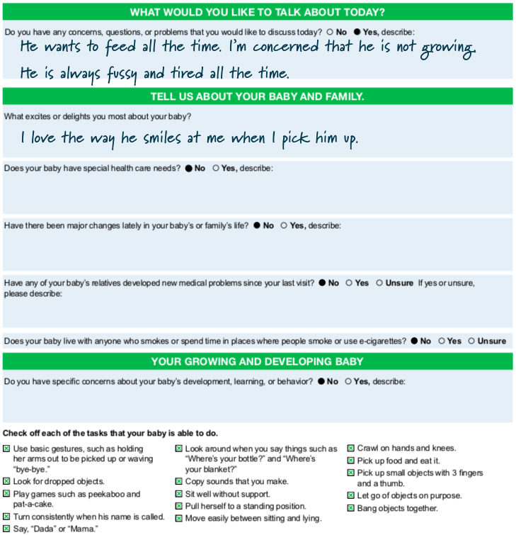
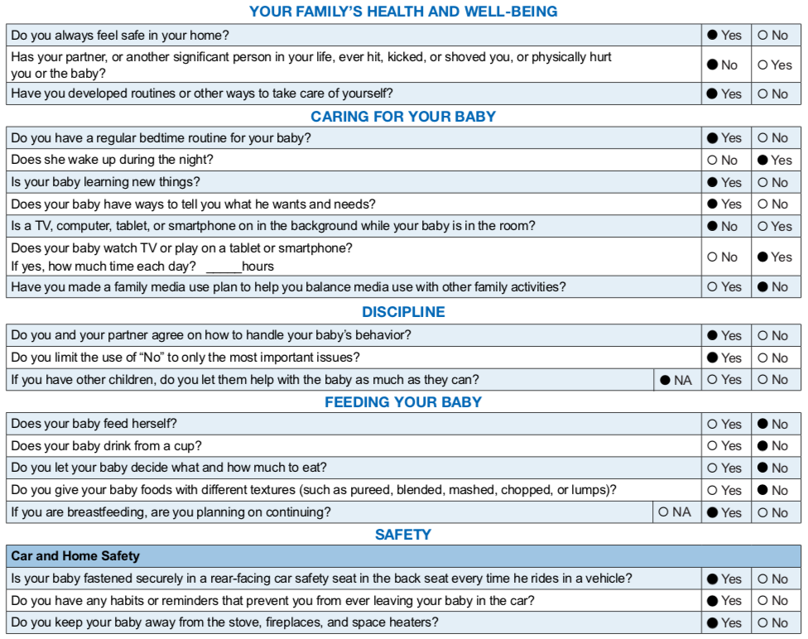
BF Pre-visit Questionnaire
Notes:
Facilitator Guide:
Consider giving the mother the Bright Futures Previsit Questionnaire (PVQ) before the visit begins.
The PVQ helps set the agenda - what the parent wants to talk about-, look for what’s going right with the child and family relationship, and obtain developmental surveillance information. While you are reviewing the PVQ, you note that the parent wrote the “He wants to feed all the time. I’m concerned that he is not growing. He is always fussy and tired all the time.”
During the visit, you should acknowledge and reinforce positive parent-infant interactions and discuss concerns.

Slide 11
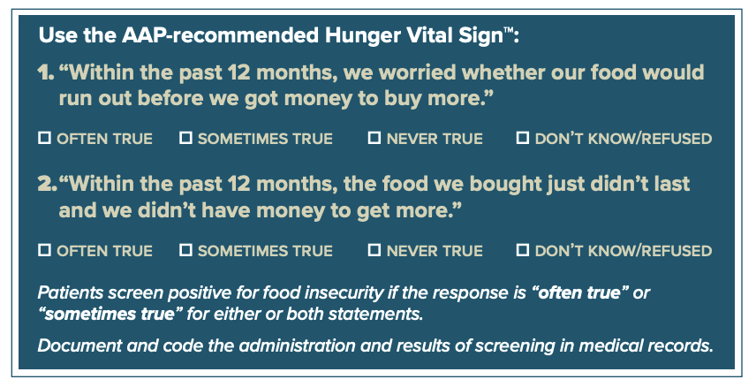
Hunger Vital SignTM
✔
✔
Source: https://childrenshealthwatch.org/public-policy/hunger-vital-sign/
Notes:
Facilitator Guide:
Patient screen positive for insecurity because the response is “often true” or “sometimes true” for both statements.

Slide 12
Self-Assessment
Based on the infant’s history, physical exam, pre-visit questionnaire, Hunger Vital SignTM, developmental screening responses, what red flags should the clinician focus on and why?
?
Notes:
Facilitator Guide:
Having gone through the infant’s history, physical exam, Bright Futures Previsit Questionnaire, Hunger Vital Sign and SWYC responses, what red flags should be considered and why?

Slide 13
Self-Assessment
Parental concern about feeding
Low weight
Feeding practices
Positive screen on Hunger Vital SignTM
!
Notes:
Facilitator Guide:
Red flags should include: the infant “always wants to eat, ” growth history, only breast feeding for nutrition, and positive screen on Hunger Vital Sign.

Slide 14
Source: Bright Futures Guidelines, 4th Edition: Infancy Visits
Notes:
Facilitator Guide:
Bright Futures Priorities for the 9-month visit include discussions on nutrition and feeding.

Slide 15
Risk Factor for Food Insecurity
Rate of food security in 2019 were statistically significantly higher than the national average of 10.5% for the following households:
all households with children
household that include a child <6 years old
households headed by single parent or caregiver
Black and Hispanic/Latino households
households with incomes below 185% of the federal poverty line
Source: Screen and Intervene: A Toolkit for Pediatricians to
Address Food Insecurity
Notes:
Facilitator Guide:
Rate of food security in 2019 were statistically significantly higher than the national average of 10.5% for the following households:
all households with children
household that include a child <6 yrs old
households headed by single parent or caregiver
Black and Hispanic/Latino households
households with incomes below 185% of the federal poverty line

Slide 16
Adverse Health Outcomes
Newborns with food insecurity are more likely to experience birth defects, birth complications, or low birth weight.
Children (4-36 mos) who live in low-income households with food insecurity may have higher rates of developmental problems.
Food insecurity is linked with lower cognitive indicators, dysregulated behaviors, and emotional distress.
Children with food insecurity are more likely to be have overall worse general health, increased ED utilization, and higher rate of forgone medical care.
Source: Screen and Intervene: A Toolkit for Pediatricians to
Address Food Insecurity
Notes:
Facilitator Guide:
Food insecurity is especially detrimental to the health and development of children.:
Studies have shown that newborns with food insecurity are more likely to experience birth defects, birth complications, or low birth weight.
Children between four and 36 months who live in low-income households with food insecurity may have higher rates of developmental delays when compared with children of the same age living without insecurity.
Among children of all ages, food insecurity is linked with lower cognitive indicators, dysregulated behaviors, and emotional distress.
Children with food insecurity are more likely to be have overall worse general health, increased ED utilization, and higher rate of forgone medical care.

Slide 17
Nutritional Deficiencies
Children who are experiencing food insecurity may present signs of nutritional deficiencies that can manifest in the following ways:
developmental delay
behavioral problems
depression, anxiety or stress
iron deficiency anemia or other nutritional deficiencies
underweight or overweight
slow growth
inappropriate feeding practices
dental caries
Source: Screen and Intervene: A Toolkit for Pediatricians to
Address Food Insecurity
Notes:
Facilitator Guide:
Children who are experiencing food insecurity may present signs of nutritional deficiencies that can manifest in the following ways:
developmental delay
behavioral problems
depression, anxiety or stress
iron deficiency anemia or other nutritional deficiencies
underweight or overweight
slow growth
inappropriate feeding practices
dental caries

Slide 18
Anticipatory Guidance
Knowledge Questions
Based on the parent’s concerns and your assessment, what aspects of anticipatory guidance for this family would you highlight?
What assistance can be offered to the family?
Notes:
Facilitator Guide:
Based on the parent’s concern and your assessment, what aspects of anticipatory guidance for this family would you highlight?
What assistance can be offered to the family?

Slide 19
Anticipatory Guidance Feedback
Discuss weaning of breast milk
Discuss transition to solids
Discuss food insecurity and using emergency food assistance and federal nutrition program assistance
Discuss plans for weaning
Discuss self-feeding, mealtime routines, transition to solid foods, cup drinking
Discuss food insecurity
Sample questions for each topic can be found in: Bright Futures Guidelines, 4th Edition: Infancy Visits
Notes:
Facilitator Guide:
Discuss weaning of breast milk
Discuss transition to solids
Discuss food insecurity and using emergency food assistance and federal nutrition program assistance

Slide 20
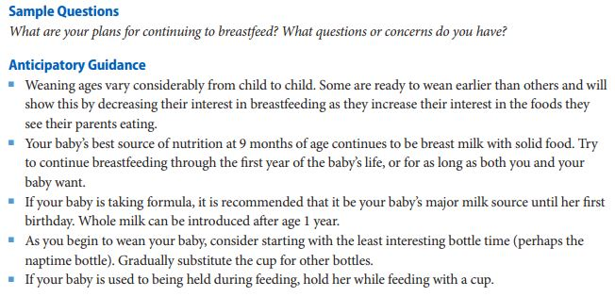
Plans for Weaning
Source: Bright Futures Guidelines, 4th Edition: Infancy Visits
Notes:
Facilitator Guide:
Using sample questions listed in the Bright Futures Guidelines to invite discussion, gather information, address the needs, and build partnership.
Anticipatory guidance geared to this case study should include:
Weaning ages vary considerably from child to child. He may be ready to wean and will show this by decreasing his interest in breastfeeding as he increase his interest in food he sees you eating
Best source of nutrition at this age is still breastmilk with solid food.
As you begin to wean him, consider starting with the least interesting bottle time. Gradually substitute the cup for other bottles.
If he is used to being held during feeding, hold him while feeding with a cup.

Slide 21
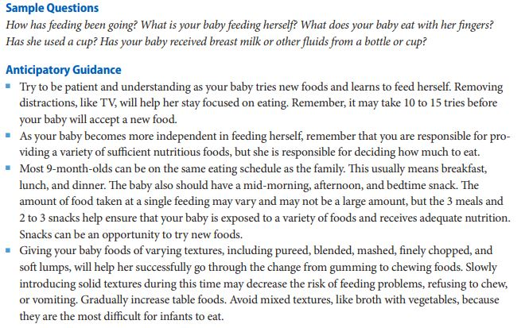
Transition to Solids
Source: Bright Futures Guidelines, 4th Edition: Infancy Visits
Notes:
Facilitator Guide:
Anticipatory guidance on transition to solids should include:
Try to be patient as he tries new foods and learns to feed himself. Removing distractions, like TV, will help him stay focused on eating. Remember, it may take 10-15 tries before he will accept a new food.
As he becomes more independent in feeding himself, remember that you are responsible for providing a variety of sufficient nutritious foods, but he is responsible for deciding how much to eat.
He can be on the same eating schedule as the family. He should have mid-morning, afternoon, and bedtime snack. The amount of food taken at a single feeding may vary and may not be a large amount but the 3 meals and 2-3 snacks help ensure he is exposed to variety of foods and receive adequate nutrition.

Slide 22
Food Insecurity
Inform mother that assistance is available and everyone needs assistance at some point in their lives. This will help take away stigma of using emergency food assistance and federal nutrition program assistance.
Talk positively about federal nutrition programs, like WIC and SNAP, and be clear that you recommend food assistance just as you would prescribe a medication. For instance, “SNAP will help you buy fruits and vegetables you child needs to grow and stay healthy.”
If mother have used the nutrition programs before, ask about her experience with these programs in the past and any challenges faced in accessing these programs that she may need assistance with addressing.
Families may already be participating in SNAP or not be eligible. SNAP benefits often run out before the end of the month since the benefit level is inadequate. Consequently, it important to identify a range of nutrition and other resources that can help families.
Source: Screen and Intervene: A Toolkit for Pediatricians to
Address Food Insecurity
Notes:
Narration:
Anticipatory guidance regarding food insecurity should include:
Inform mother that assistance is available and everyone needs assistance at some point in their lives. This will help take away stigma of using emergency food assistance and federal nutrition program assistance.
Talk positively about federal nutrition programs, like WIC and SNAP, and be clear that you recommend food assistance just as you would prescribe a medication. For instance, “SNAP will help you buy fruits and vegetables you child needs to grow and stay healthy.”
If mother have used the nutrition programs before, ask about her experience with these programs in the past and any challenges faced in accessing these programs that she may need assistance with addressing.
Families may already be participating in SNAP or not be eligible. SNAP benefits often run out before the end of the month since the benefit level is inadequate. Consequently, it important to identify a range of nutrition and other resources that can help families.

Slide 23
Food Insecurity
If you have an on-site food pantry or food shelf, make sure it is located where patients can access food in private.
Provide reassurance that many people face financial hardship at some point in their lives. Acknowledge that some people are embarrassed to admit that they are struggling or they need help. Commend the mother for her honesty about the issue.
If staffing allows, make calls to program such as WIC, or complete applications for SNAP while the family is present.
Consider developing partnership with community organizations or local SNAP or WIC agencies to help ease patient access to programs.
Source: Screen and Intervene: A Toolkit for Pediatricians to
Address Food Insecurity
Notes:
Facilitator Guide:
Anticipatory guidance regarding food insecurity should include:
If you have an on-site food pantry or food shelf, make sure it is located where patients can access food in private.
Provide reassurance that many people face financial hardship at some point in their lives. Acknowledge that some people are embarrassed to admit that they are struggling or they need help. Commend the mother for her honesty about the issue.
If staffing allows, make calls to program such as WIC, or complete applications for SNAP while the family is present.
Consider developing partnership with community organizations or local SNAP or WIC agencies to help ease patient access to programs.

Slide 24
Emergency Food Assistance
Source: Screen and Intervene: A Toolkit for Pediatricians to
Address Food Insecurity
Notes:
Facilitator Guide:
Connecting patients to emergency food sources is important option in many communities, especially for addressing immediate needs.
Some practices collect non-perishable food stables that are stored on site. Others though partnership with local food bank, distribute bags of groceries to patients periodically. Pediatric health care practitioners can also distribute gift cards to local supermarket to families in need of immediate food assistance.

Slide 25
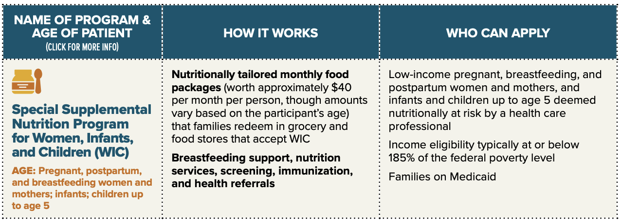
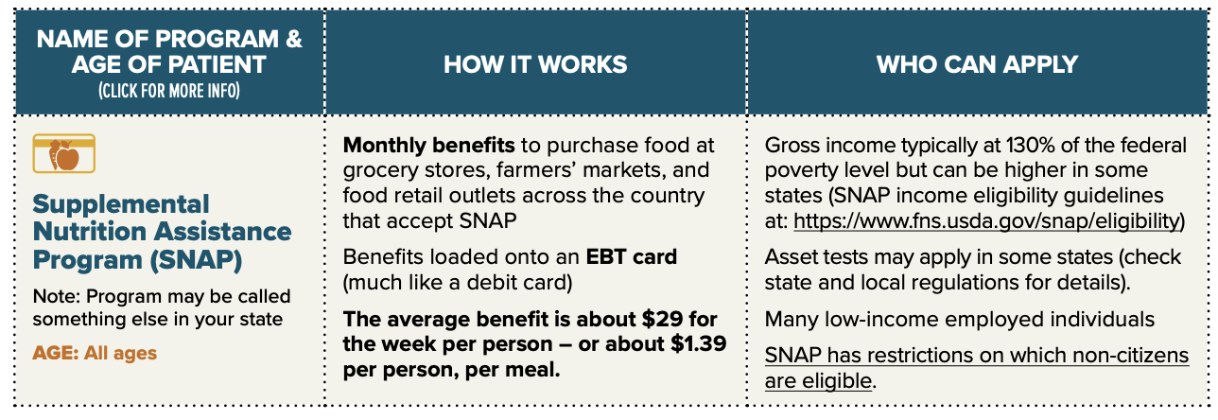
Community Agencies and Program
Source: Screen and Intervene: A Toolkit for Pediatricians to
Address Food Insecurity
Notes:
Facilitator Guide:
According to the AAP, the federal nutrition programs “serve as critical supports for the physical and mental health and academic competence of children” for tens of millions of children. The key federal nutrition programs include SNAP, WIC, child care meals, school meals, afterschool snacks and meal, and summer food.
WIC provides nutritious foods, nutrition education and counseling, and access to health care for low-income pregnant and postpartum women, new mothers, infants and children up to 5 years old who are at nutritional risk.
SNAP, previously known as food stamps is the largest federal nutrition program. SNAP benefits are loaded onto an EBT card so that participants can purchase food at supermarkets, farmer’s market, and other food stores.

Slide 26
Community Agencies and Program
Source: Screen and Intervene: A Toolkit for Pediatricians to
Address Food Insecurity
Notes:
Facilitator Guide:
School Meals boost children’s nutrition, health, and education achievement by reimbursing public and nonprofit private schools that provides school meals and snacks to children. Federally funded school meals must comply with national nutrition standards. Through community eligibility, high-poverty schools can offer all students free breakfast and lunch.
The National School Lunch Program makes it possible for all school children to receive a nutritious lunch every school day.
The School Breakfast Program offers a nutritious meal to start the school day. The program works best when school offer free breakfast to all students and make it part of the school day through alternative delivery models (eg, breakfast in the classroom, “grab and go,” second chance breakfast).
CACFP funds free nutritious meals and snacks for young children in child care centers, family child care homes, and Head Start or Early Head Start programs.

Slide 27
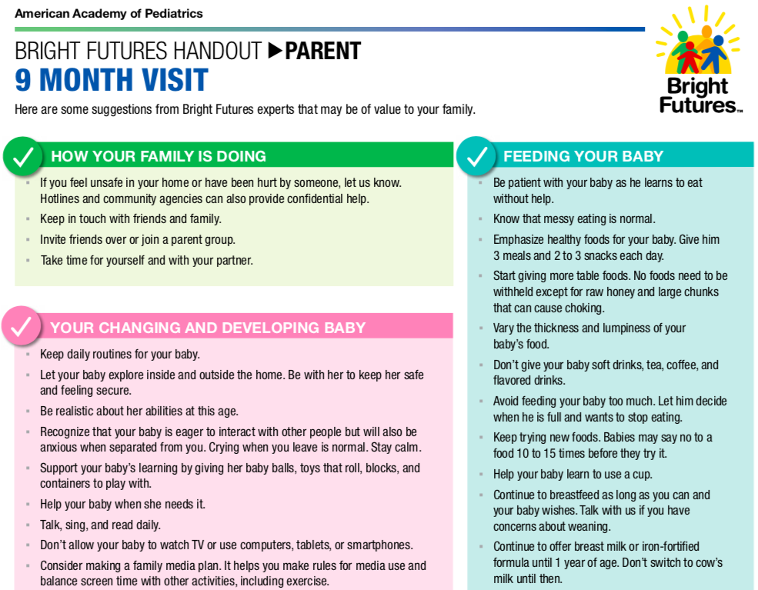
Reinforce Anticipatory Guidance
Online version of Parent Education can be found here: https://downloads.aap.org/AAP/PDF/Bright%20Futures/bftk_parent_handout_9month.pdf
Notes:
Facilitator Guide:
Consider giving the parent the Bright Futures Parent Educational Handout to reinforce anticipatory guidance topics pertinent to this case.

Slide 28
Teaching Points
Assess for lack of food in child that has poor weight gain
Know the resources to provide for families that have lack of food
Keep in mind cultural factors when providing education
Notes:
Facilitator Guide:
Teaching point for this mini module include:
Assess for lack of food in child that has poor weight gain
Know the resources to provide for families that have lack of food
Keep in mind cultural factors when providing education

Slide 29
Post-test
Test your knowledge about the topic and review feedback on your responses. Please click the post-test link below.
Please click on link to be routed to the post-test
NOTE: This is for learning purposes only and is NOT approved for CME.
Notes:
Facilitator Guide:
Please complete the post-test to check your knowledge before exiting the program

Slide 30
Resources
Clinician Resources
SCREEN and INTERVENE: A Toolkit for Pediatricians to Address Food Insecurity
The Center on the Developing Child
Center for the Study of Social Policy: Strengthening Families
AAP Institute for Healthy Childhood Weight (IHCW): Building a Foundation for Healthy Living
AAP Food Insecurity
AAP Screen & Intervene: Addressing Food Insecurity Webinar
Conversations About Podcast
AAP Policy
Promoting Food Security for All Children
Bright Futures Resources
Bright Futures Guidelines and Pocket Guide
Integrating Social Determinants of Health Into Health Supervision Visits
Promoting Lifelong Health for Families and Communities
Promoting Healthy Development
Promoting Healthy Weight
Promoting Healthy Nutrition

Slide 31
Resources
AAP Resources
Promoting Food Security for All Children
Promoting Optimal Development: Identifying Infants and Young Children With Developmental Disorders Through Developmental Surveillance and Screening
Preventing Childhood Toxic Stress: Partnering With Families and Communities to Promote Relational Health
Resources for Families
Feeding America
Zero to Three
HealthyChildren.org
USDA Dietary Guidelines for Americans

Slide 32
References
Hager ER, Quigg AM, Black MM, Coleman SM, Heeren T, Rose-Jacobs R, Cook JT, Ettinger de Cuba SE, Casey PH, Chilton M, Cutts DB, Meyers AF, Frank DA. Development and Validity of a 2-Item Screen to Identify Families at Risk for Food Insecurity. Pediatrics 2010; 126(1), 26-32.
Coleman-Jensen A, Rabbit MP, Gregory CA, Singh A. (2022). Household Food Security in the Unites States in 2021.
Gitterman BA, Chilton LA, Cotton WH, Duffee JH, Flanagan P, Keane VA, Krugman SD, Kuo AA, Linton JM, McKelvey CD, Paz-Soldan CJ, Daniels SR, Abrams SA, Corkins MR, de Ferranti SD, Golden NH, Magge SN, Schwarzenberg SJ; Promoting Food Security for All Children. Pediatrics 2015; 136 (5): e1431–e1438.
Hake M, Engelhard E, Dewey A. (2022). Map the Meal Gap 2022; An Analysis of County and Congressional District Food Insecurity and County Food Cost in the United States in 2020. Feeding America.
Chilton M, Black MM, Berkowitz C, Casey PH, Cook J, Cutts D, Jacobs RR, Heeren T, Ettinger de Cuba S, Coleman S, Meyers A, Frank DA. Food Insecurity and Risk of Poor Health Among US-Born Children of Immigrants. Am J Public Health. 2009; 99(3);556-562.
Jernigan VBB, Huyser KR, Valdes J, Simonds VW. Food Insecurity among American Indians and Alaska Natives: A National Profile using the Current Population Survey–Food Security Supplement. J Hunger Environ Nutri. 2017;12(1):1-10.

Slide 33
References
Coleman-Jensen A, Nord, M. Food Insecurity Among Households with Working-Age Adults with Disabilities. U.S. Department of Agriculture. Economic Research Service; 2013.
Jackson DB, Chilton M, Johnson KR, Vaughn MG. Adverse Childhood Experiences and House Food Insecurity: Findings from the 2016 National Survey of Children’s Health. Am J Med. 2019; 57(5):667-674.
Coleman-Jensen, A., Rabbit, M. P., Gregory, C. A., & Singh, A. Household Food Insecurity in the United States in 2019; 2022.
Shaw JS, Hagan JF Jr, Shepard MT, Curry ES, Swanson JT, Janies KM, eds. Bright Futures Tool and Resource Kit. 2nd ed. American Academy of Pediatrics; 2019.
Hagan JF, Shaw JS, Duncan PM: American Academy of Pediatrics. Bright Futures Guidelines for Health Supervision of Infants, Children, and Adolescents, 4th edition; 2017.

